Slide 1
HAPPY REPUBLIC DAY
Chahat
5-A

Slide 2
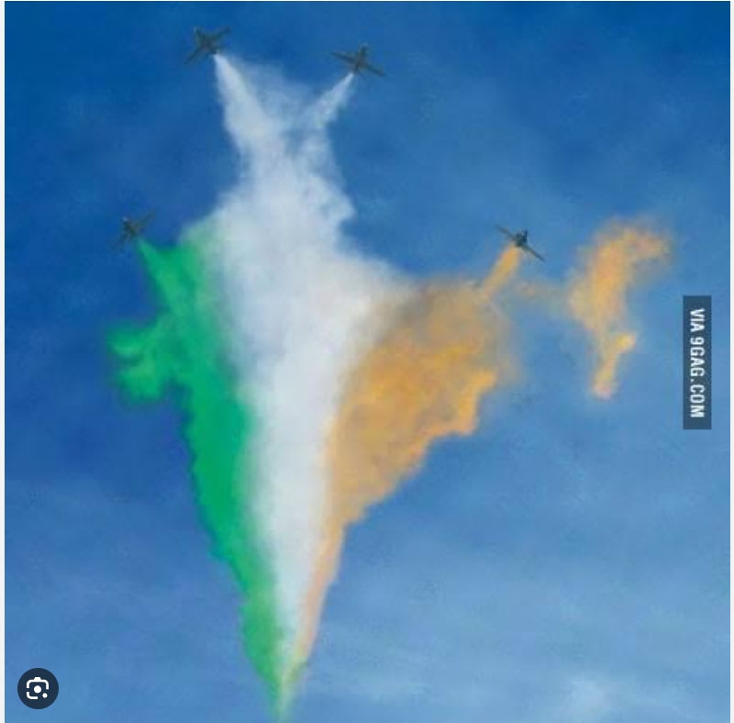

Slide 4
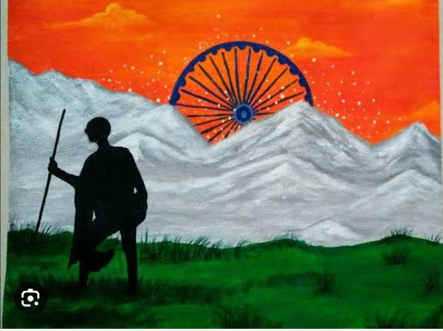

Slide 5
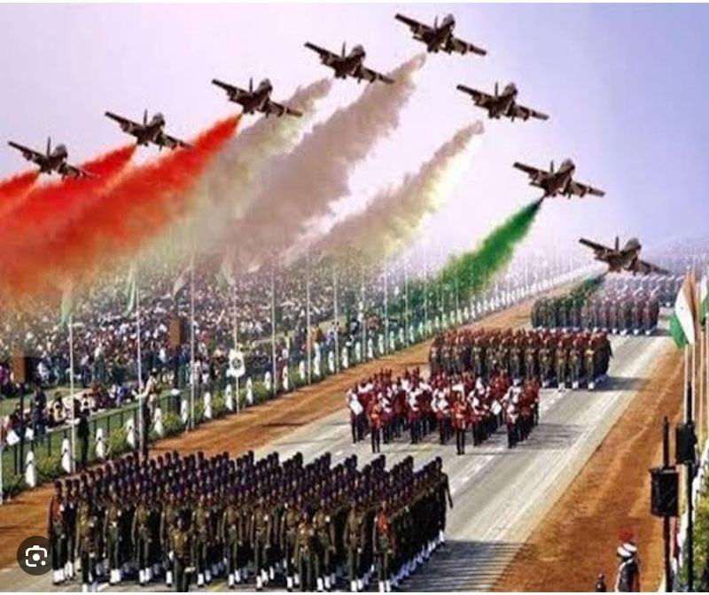

Slide 6
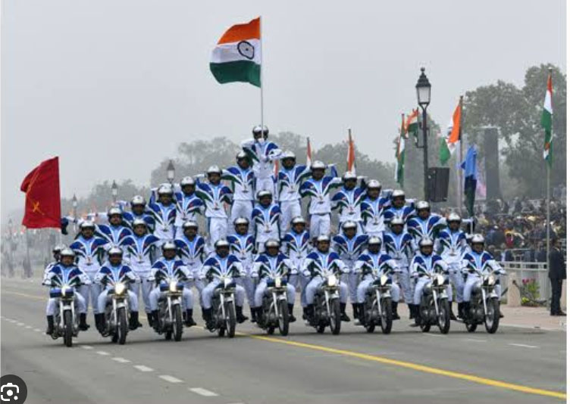

Slide 7
THANKS FOR WATCHING
HAVE A NICE
DAY

